Slide 1
Colorization of Black and White Images Using Machine Learning
Will Buchta, Deena Selitsky, Sarah Semy, & Humza Qureshi
July 23, 2024
Notes:
Will

Slide 2
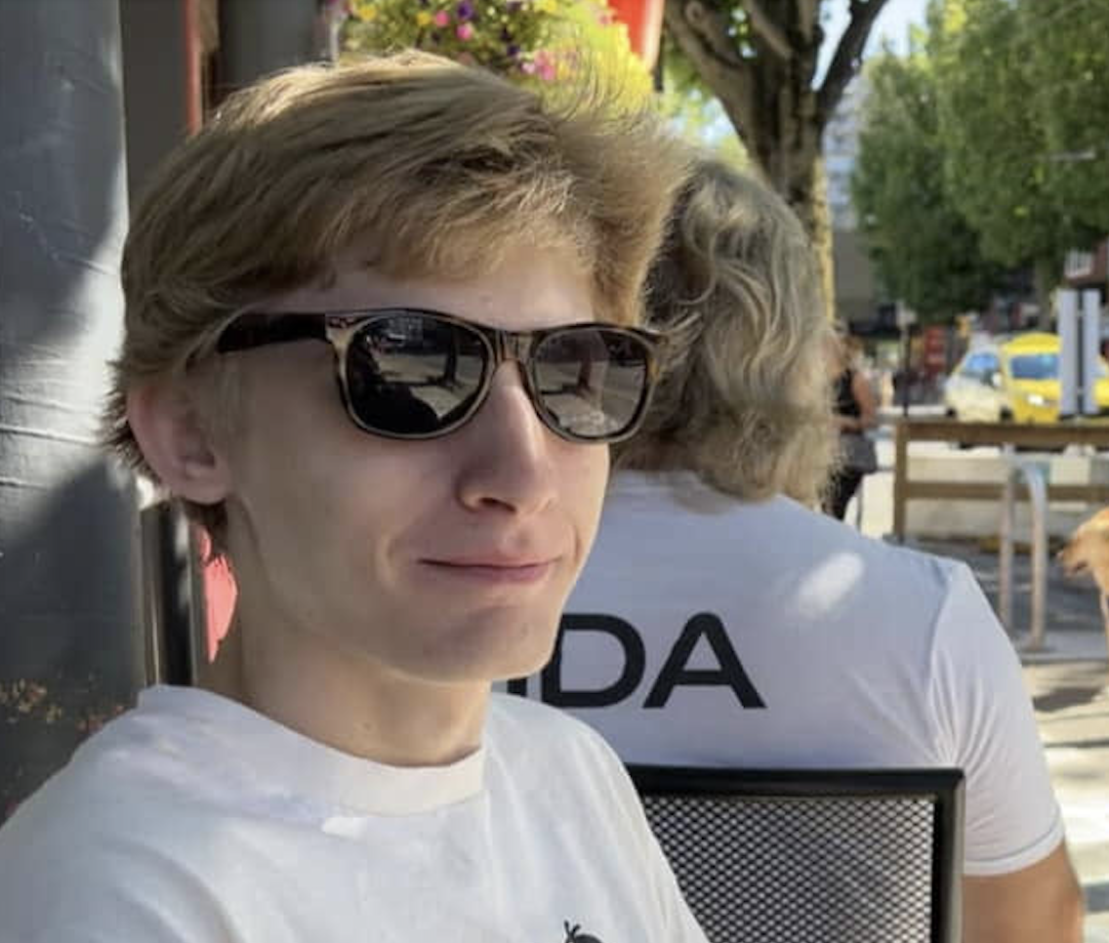

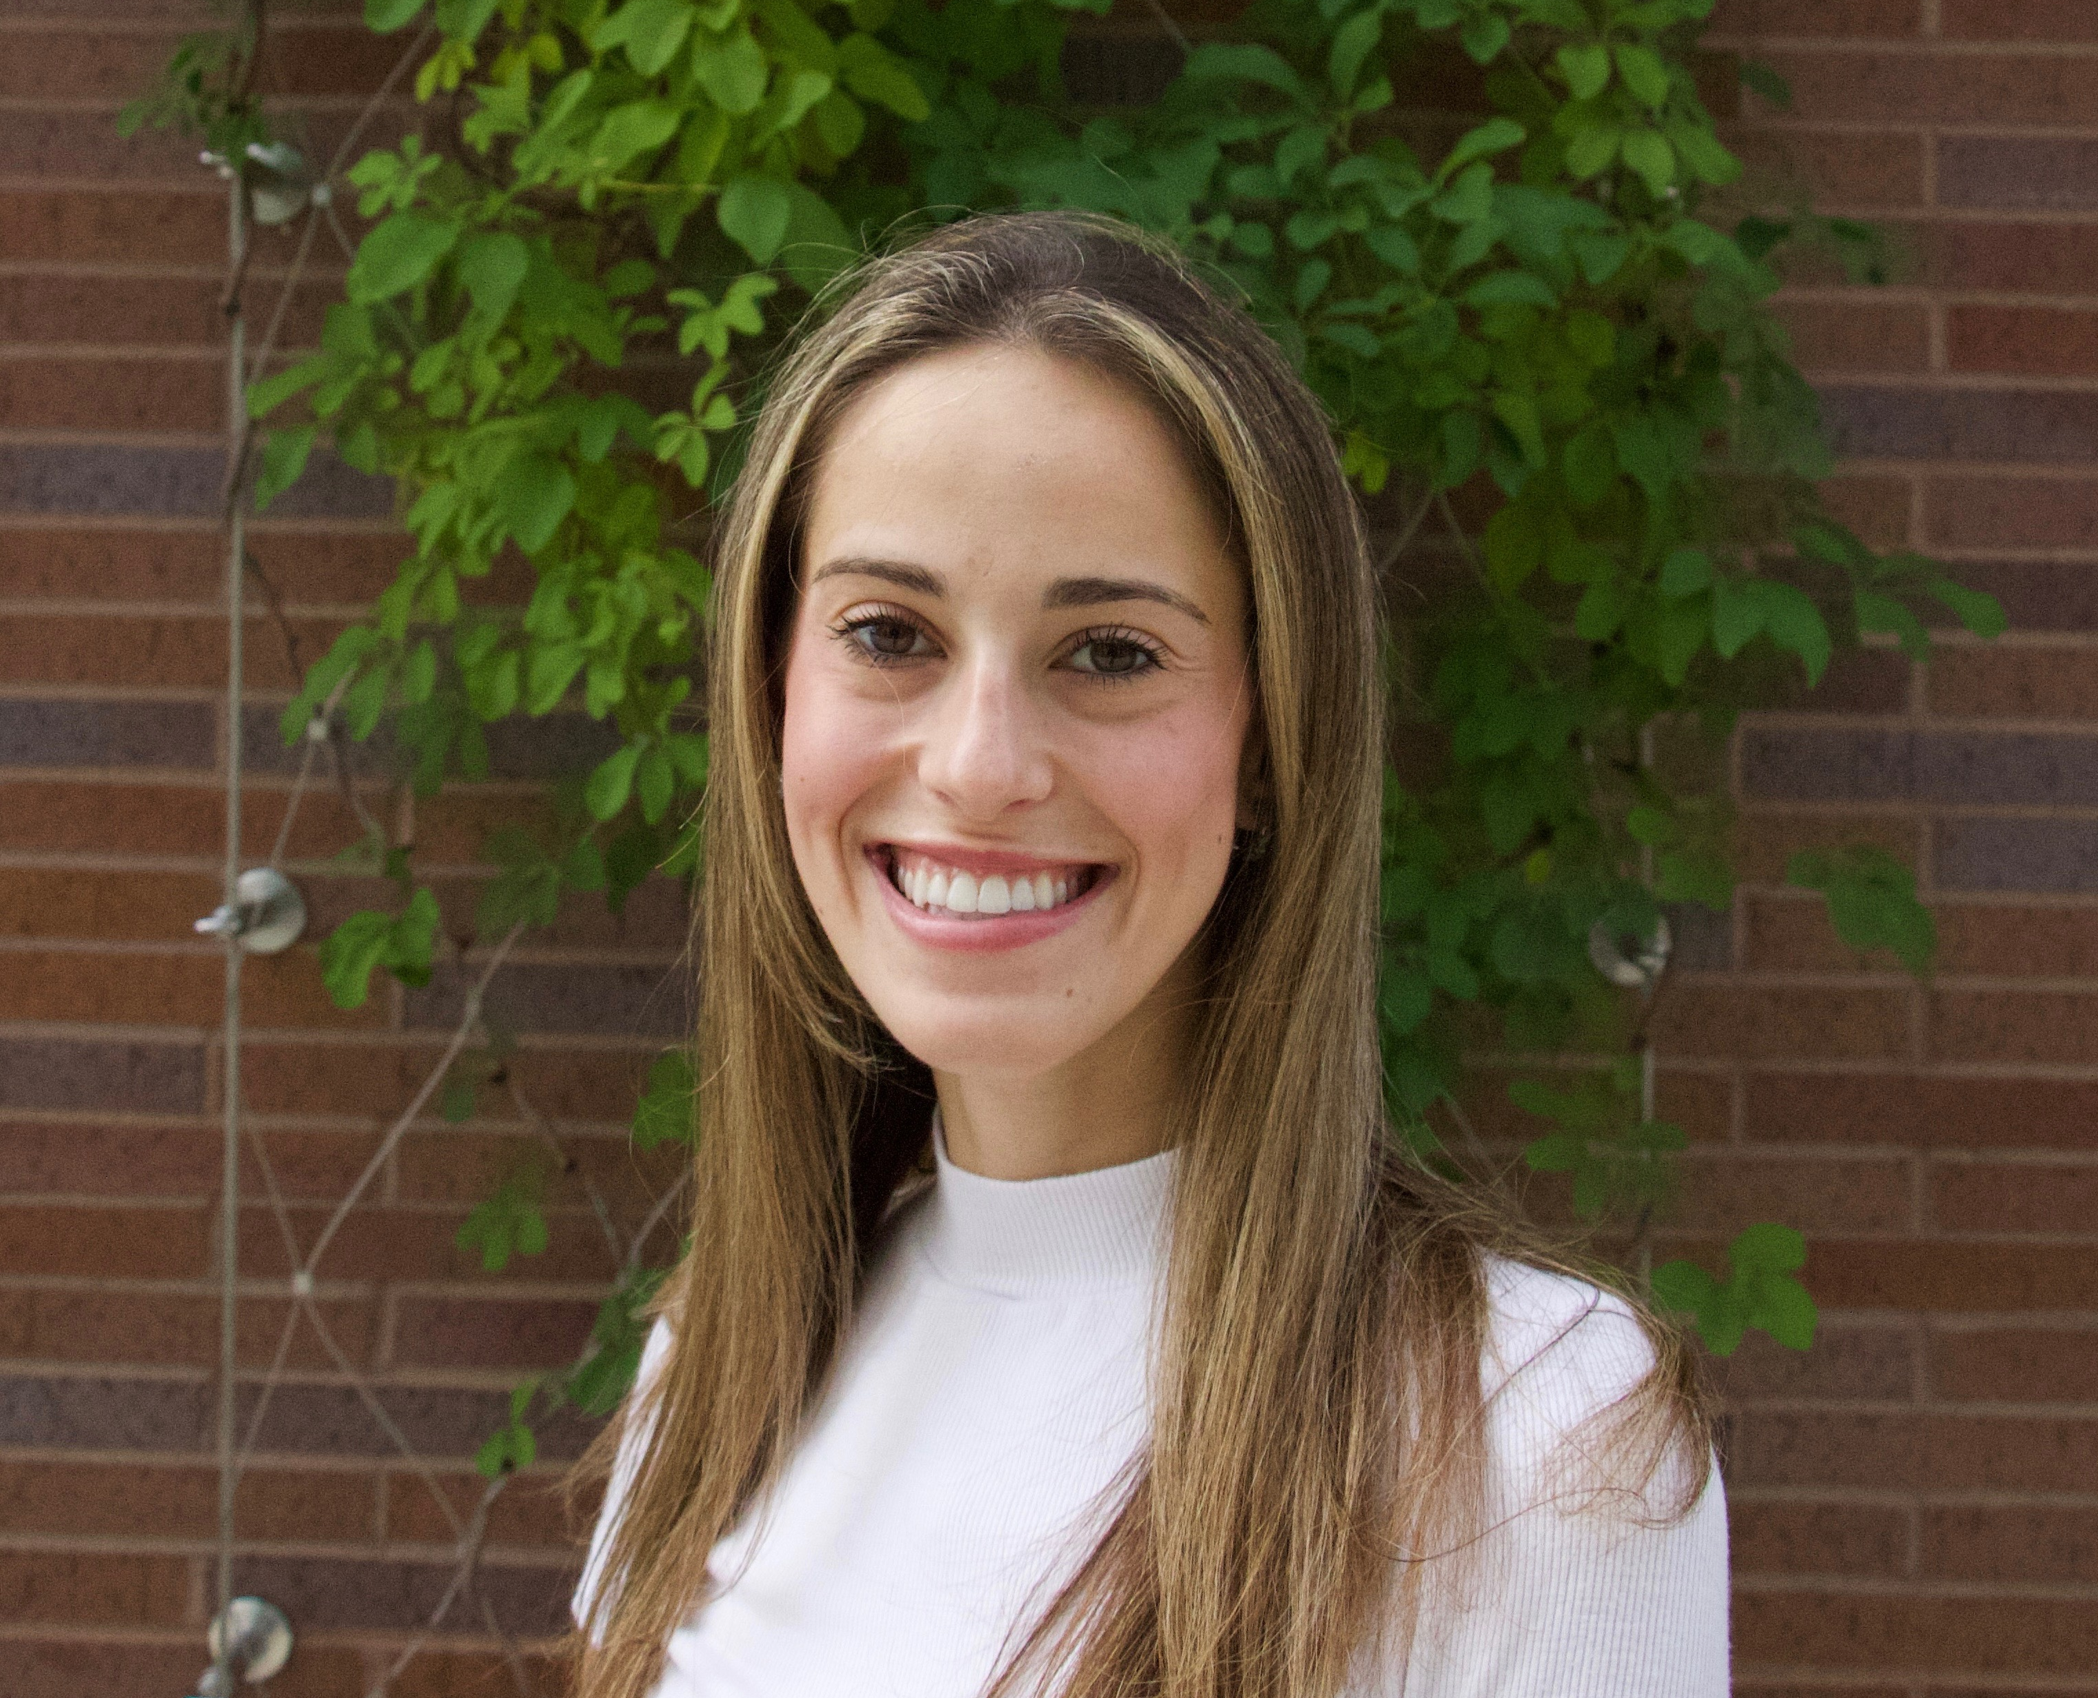

Meet The Team!
Will Buchta
Sarah Semy
ECE & CS 2025
CS 2025
Deena Selitsky
Humza Qureshi
DS 2025
DS 2025

Slide 3
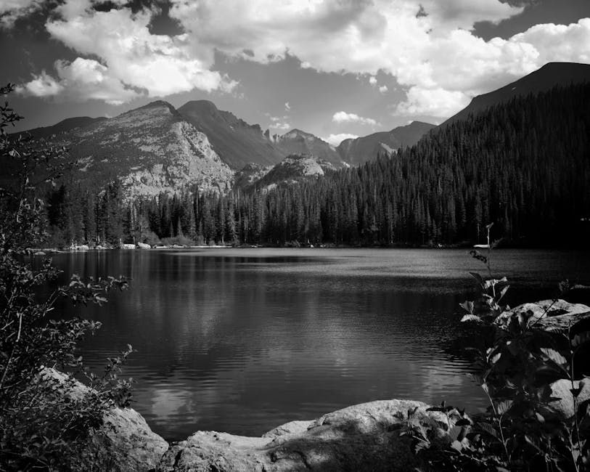
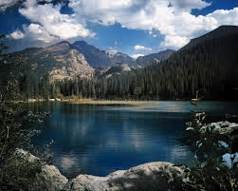
Project Objective & Overview
Aim to implement and evaluate multiple machine learning models for colorizing black and white images
Goal is to assign RGB values to monochrome images to enhance historical and practical value
Project will test and compare models' effectiveness
DeOldify, a tool that incorporates deep learning-based and GAN techniques, will be referenced for its advanced image and video colorization capabilities
Notes:
Sarah

Slide 4
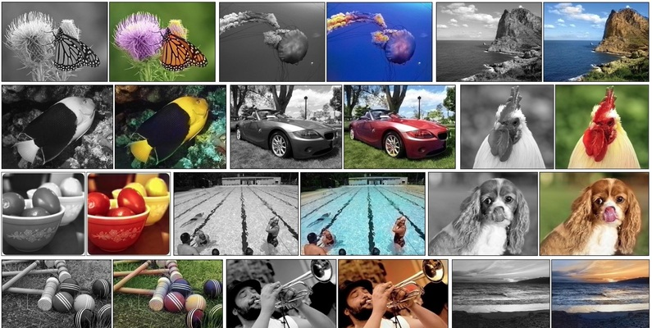
Data Preparation
5,739 400x400 pixel image pairs
Converted to tensors for faster loading and execution
kaggle.com/datasets/aayush9753/image-colorization-dataset
Notes:
We used an image colorzation dataset from Kaggle, consisting of 5739 pairs of black and white and color images. In addition to using the plain dataset, we created tensor representations of the images to speed up training.
The normal way of loading images directly takes extra time, because each time a sample is loaded, the program would have to convert it to tensor form anyways.

Slide 5

01
Autoencoder
Notes:
Will

Slide 6
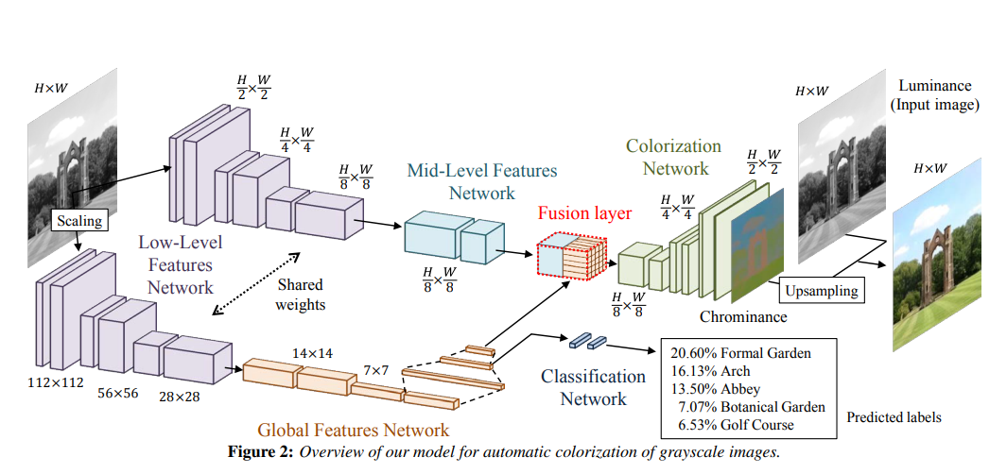
Autoencoder Architecture
https://dl.acm.org/doi/10.1145/2897824.2925974
Notes:
The model that I developed is based off a paper from 2016, which combines a vanilla autoencoder with a global feature network. The vanilla autoencoder uses a series of convolutions to create a latent representation of the input image, learning some high level features about it, then uses a decoder with a series of deconvolutions to create a new image. This leaves a lot of ambiguity in the image though, as

Slide 7
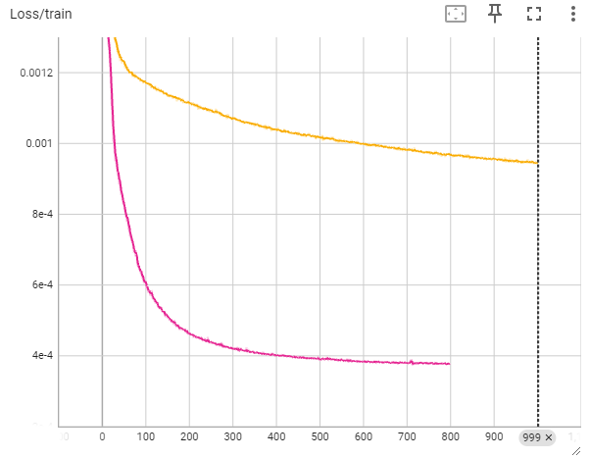
Autoencoder Training
5739 Data Samples
4878 Training Samples
Vanilla Autoencoder
Vanilla Autoencoder
Train Loss: 9.47 x 10⁻⁴
Test Loss: 17.8 x 10⁻⁴
MSE Loss
Global Fusion
Autoencoder
Global Fusion Autoencoder
Train Loss: 3.79 x 10⁻⁴
Test Loss: 15.9 x 10⁻⁴
Epoch

Slide 8
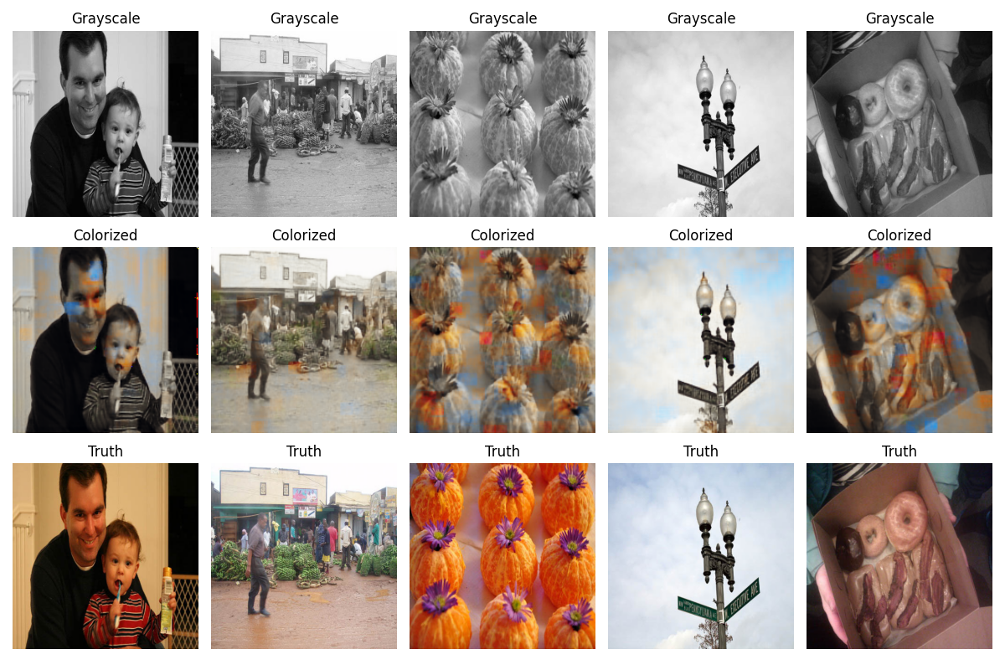
Vanilla Autoencoder Results
“Vanilla” Autoencoder after 1000 Epochs

Slide 9
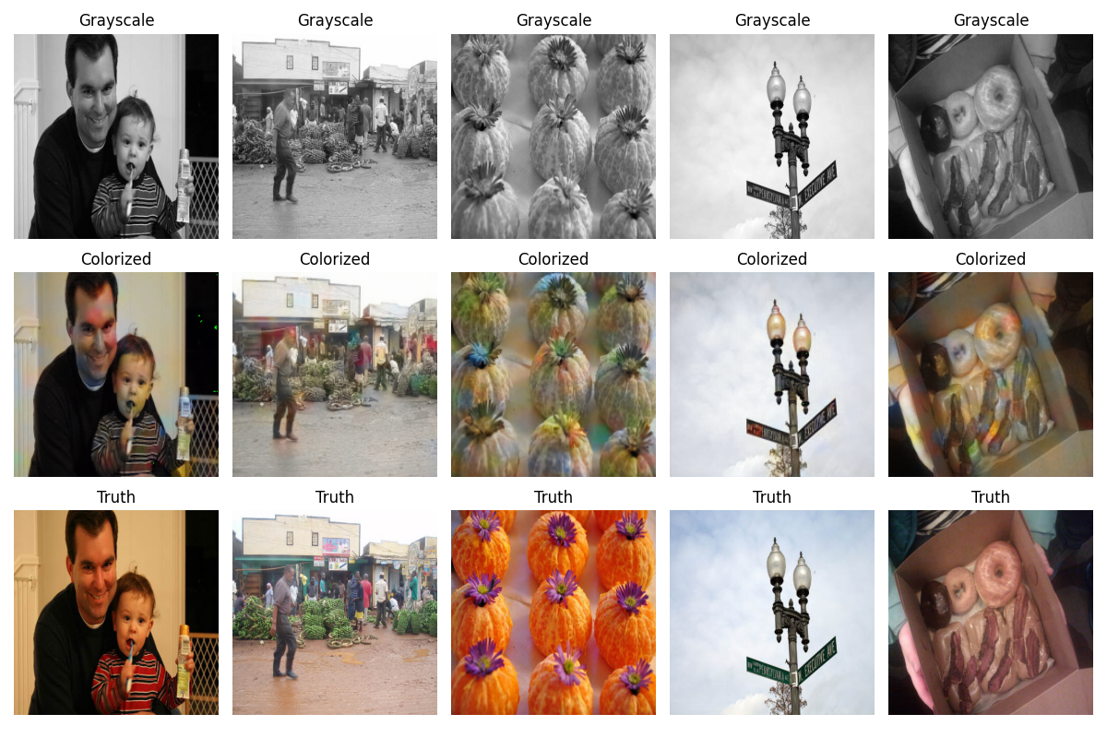
Global Fusion Autoencoder Results
“Global Fusion” Autoencoder
after 800 Epochs

Slide 10
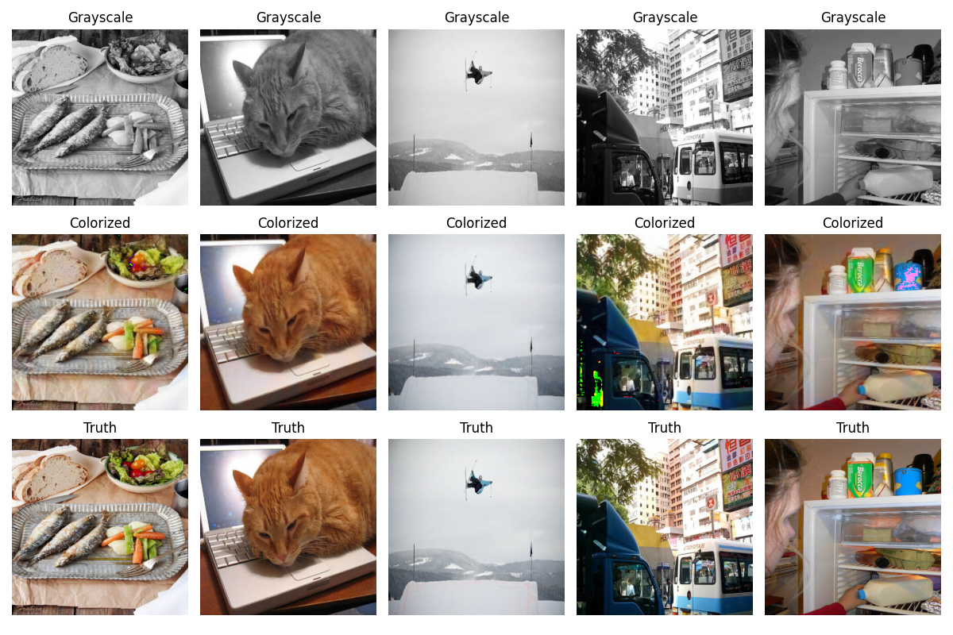
Global Fusion Autoencoder Results
“Global Fusion” Autoencoder
on Train Dataset
Future Improvements:
Investigate LAB color space
Optimize context extraction

Slide 11
02
Convolutional Neural Network

Slide 12
How does a CNN work?
A simple CNN typically has:
2-3 Convolutional Layers
2 Pooling Layers
2 Fully Connected Layers
6-8 Total Layers (excluding input and output layers)
A more complex CNN typically has:
10-100s Convolutional Layers
5-10 Pooling Layers
1-3 Fully Connected Layers
20 – 100+ Total Layers (excluding input and output layers)
A CNN is a specialized type of artificial neural network designed to process and analyze visual data

Slide 13
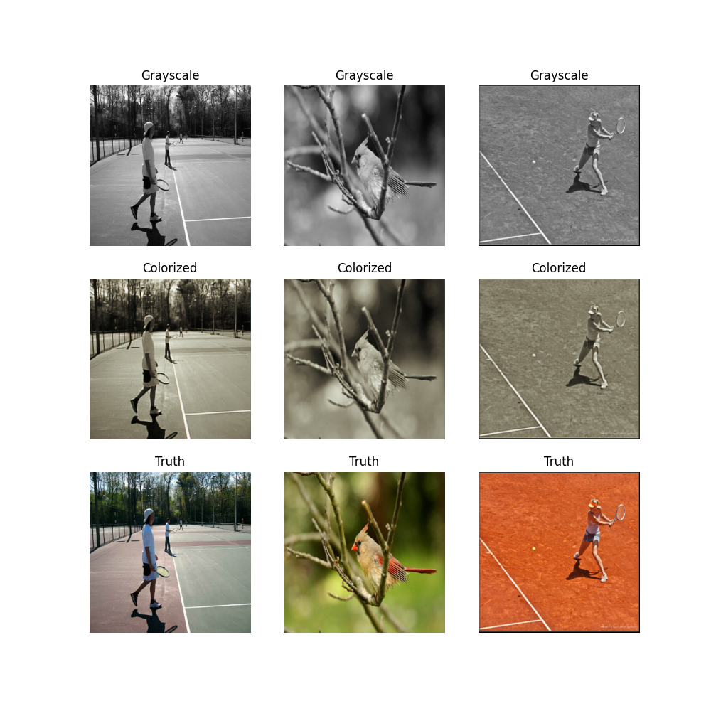
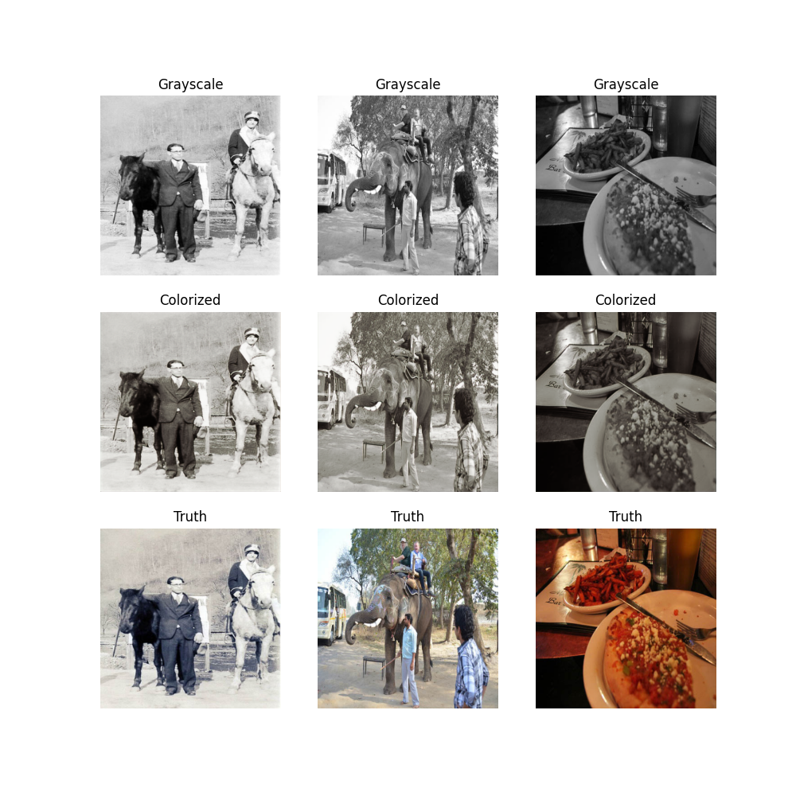
CNN Results
1 Epoch
2 Epoch
Notes:
Wasn't blurry and looked like the input image, 1 epoch was better than 2

Slide 14

Why did the CNN fail?
Insufficient Memory
CNNs need substantial RAM and GPU memory for data and computations
Lacking either can cause crashes or poor performance
Environment & Overheating
Hardware components like the GPU or CPU can overheat, causing the CNN to fail
Improvements
Train on a smaller data set that is cleaned
Reduce model complexity
Optimize parameters

Slide 15
03
Generative Adversarial Network

Slide 16
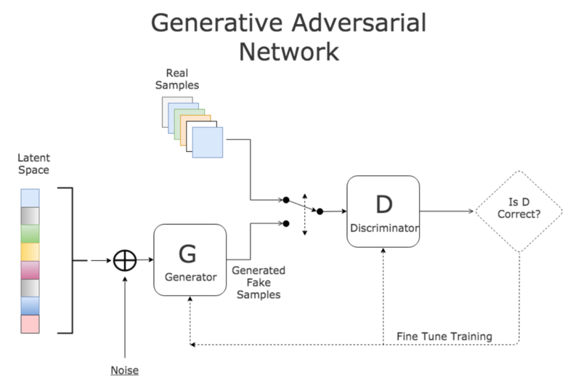
How does a GAN work?
Citation
Notes:
Contains two neural networks:
Generator: Generates images that mimics the real data
Discriminator: Attempts to distinguish between synthetic and real data produced from the generator
These two neural networks compete against each other to improve the performance of the model

Slide 17
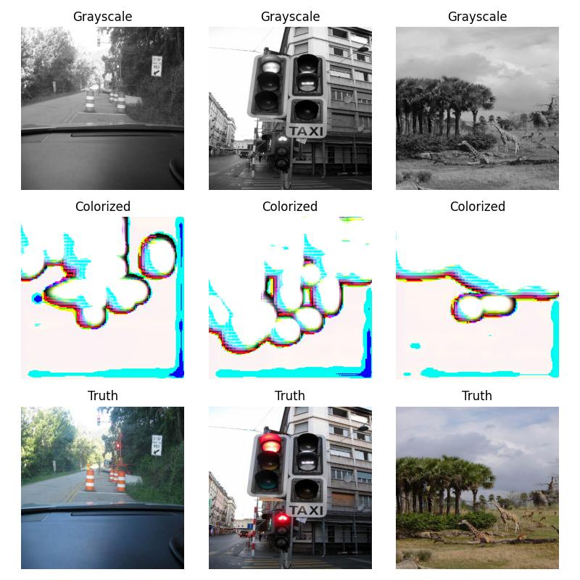
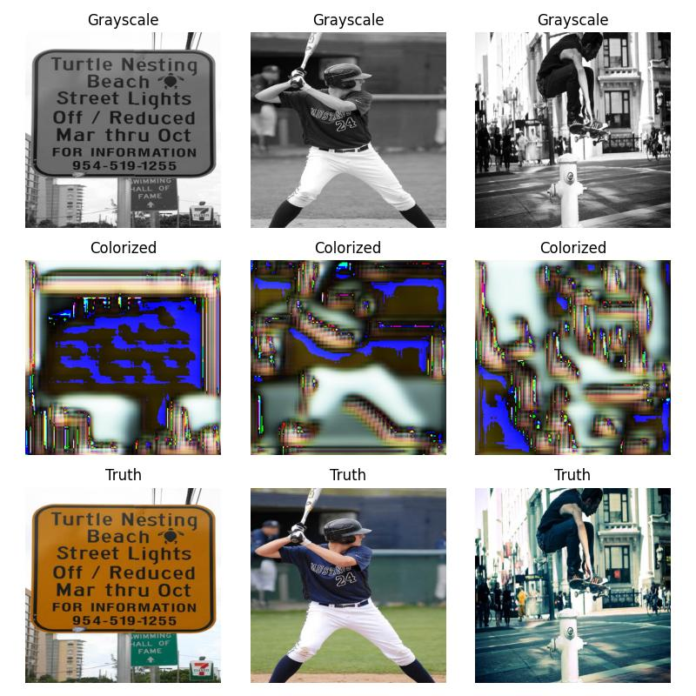
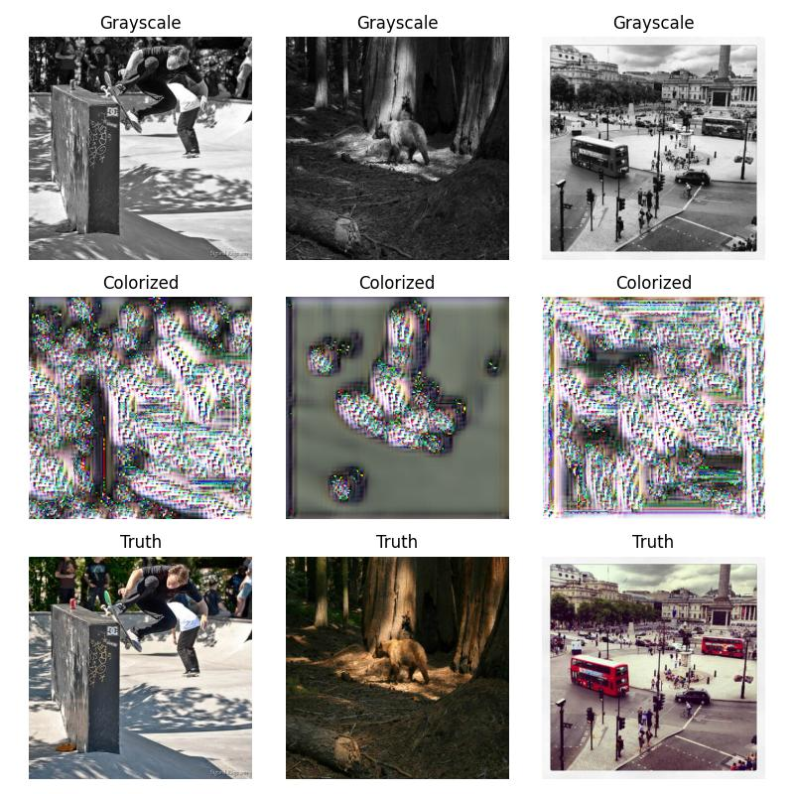
GAN Demo (10 epochs)
Epoch 0
Epoch 1
Epoch 2

Slide 18
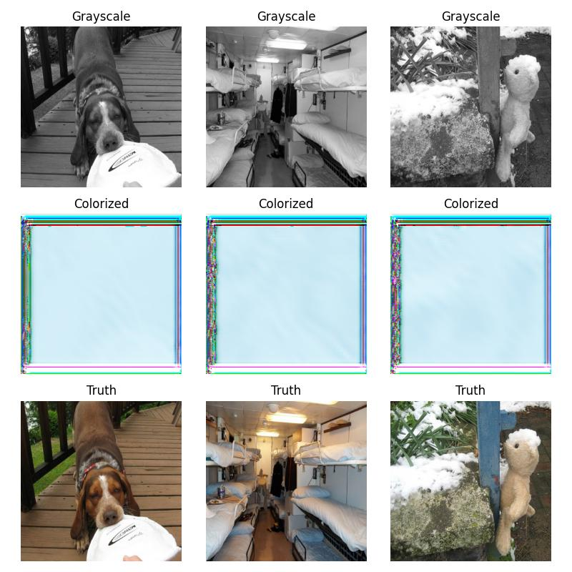
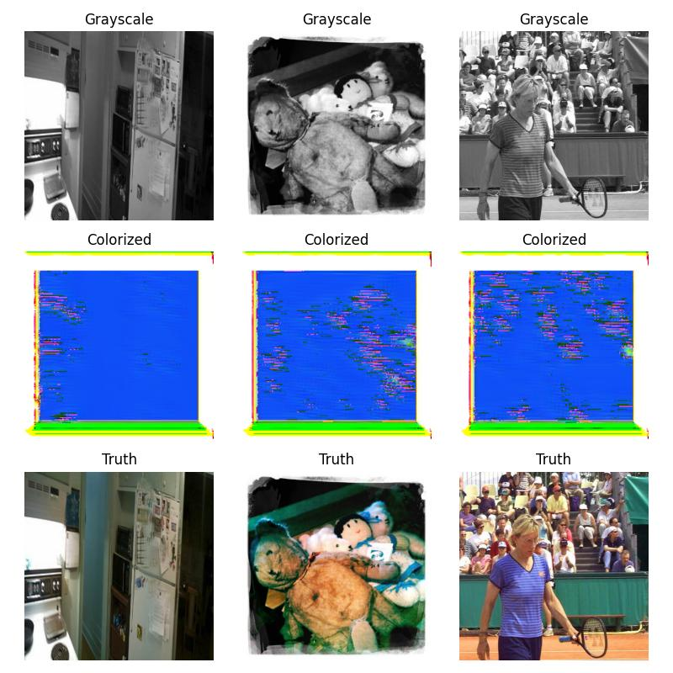
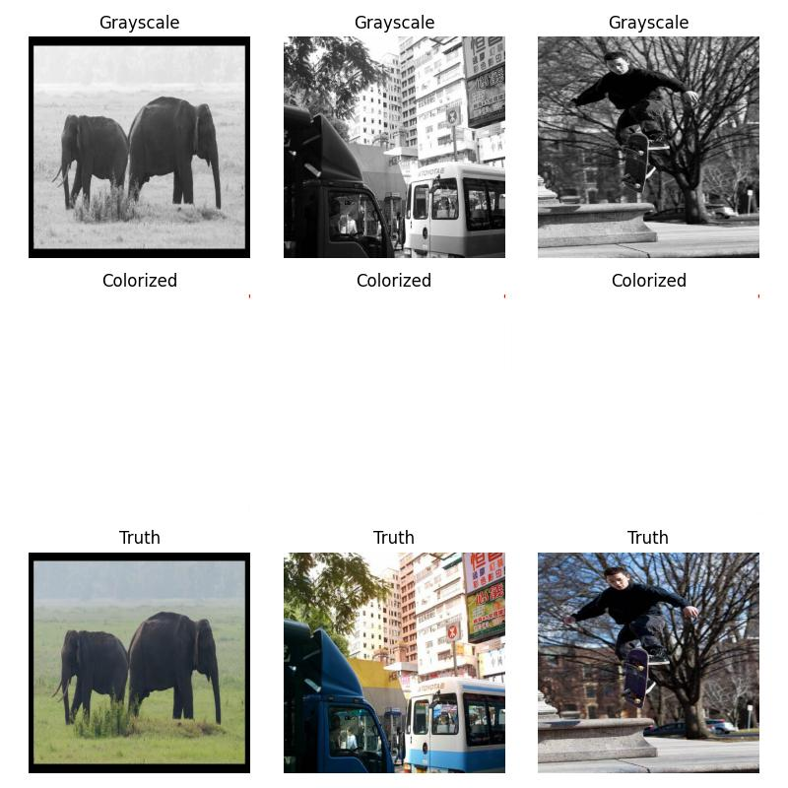
Epoch 3
Epoch 4
Epoch 5-10

Slide 19
Why did the GAN fail?
MODE COLLAPSE!
Epoch [1/10] Loss D: 1.098, loss G: 0.929
Epoch [2/10] Loss D: 1.202, loss G: 0.981
Epoch [3/10] Loss D: 0.755, loss G: 1.674
Epoch [4/10] Loss D: 0.225, loss G: 2.971
Epoch [5/10] Loss D: 0.044, loss G: 4.655
Epoch [6/10] Loss D: 0.043, loss G: 4.718
Epoch [7/10] Loss D: 0.007, loss G: 5.497
Epoch [8/10] Loss D: 0.004, loss G: 6.033
Epoch [9/10] Loss D: 0.003, loss G: 6.114
Epoch [10/10] Loss D: 0.002, loss G: 6.285
After epoch 4, there is clear indication that the discriminator has overfit
The discriminator has become too powerful
No useful information can be fed into the generator
Notes:
Gan has become overly dependent on the learning data

Slide 20
04
“NoGAN”

Slide 21
What is "NoGAN"?
Two parts: Deep Learning Based Method followed by GAN Training
Can repeat the process for better results
Deep Learning Based
Train generator solely using the feature loss
Generate images
Train the critic as a basic binary classifier to distinguish between outputs and real images
GAN Training
Train both the generator and critic together
Find the inflection point, where the image is the best quality
GitHub - jantic/DeOldify: A Deep Learning based project for colorizing and restoring old images (and video!)

Slide 22
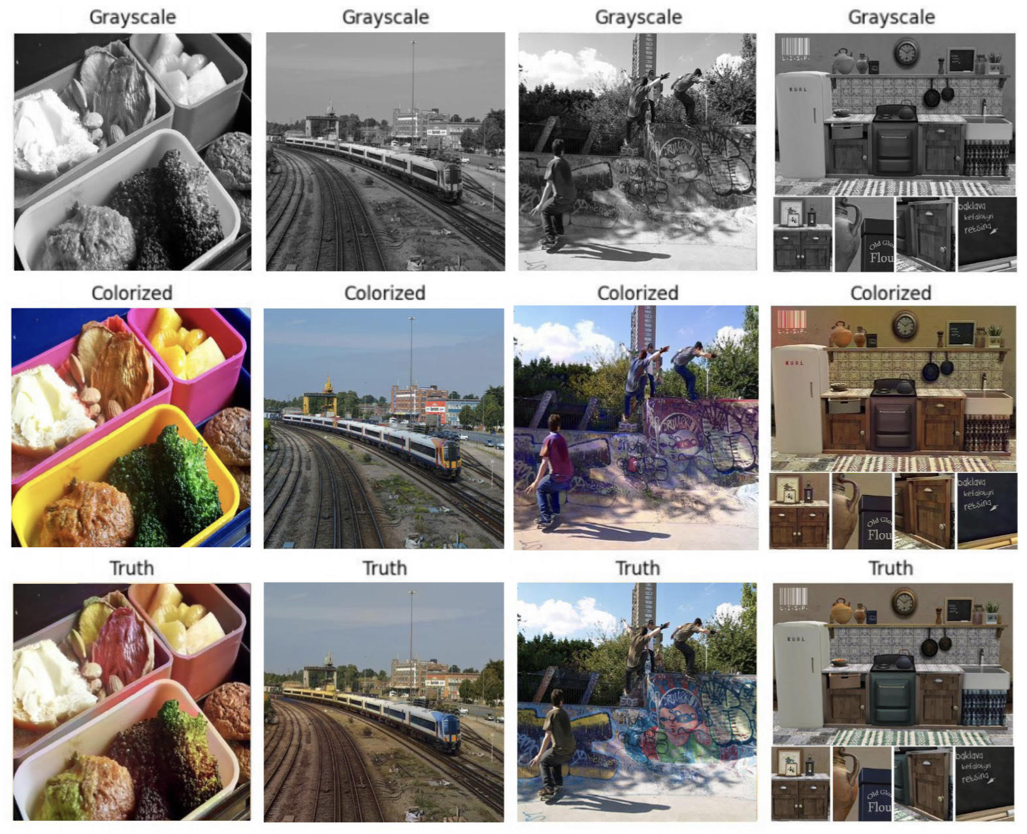
“NoGAN” Results
1000 epochs

Slide 23
Why does "NoGAN" work?
Leverages the benefits of deep learning-based models and GAN training through a combined approach
"Conventional" deep learning-based methods provide results quickly and easily
Minimal time on GAN training
Realistic colorization capabilities
Reduces glitches and artifacts
Future Improvements
Compare multiple deep learning-based models
Test DeOldify's versions (including "artistic" and "stable") using different deep learning-based models
Extend to videos

Slide 24
Comparison of Models
Autoencoder | CNN | GAN | “NoGAN”
Notes:
Humza

Slide 25
Thank You!
Questions?

